Slide 1


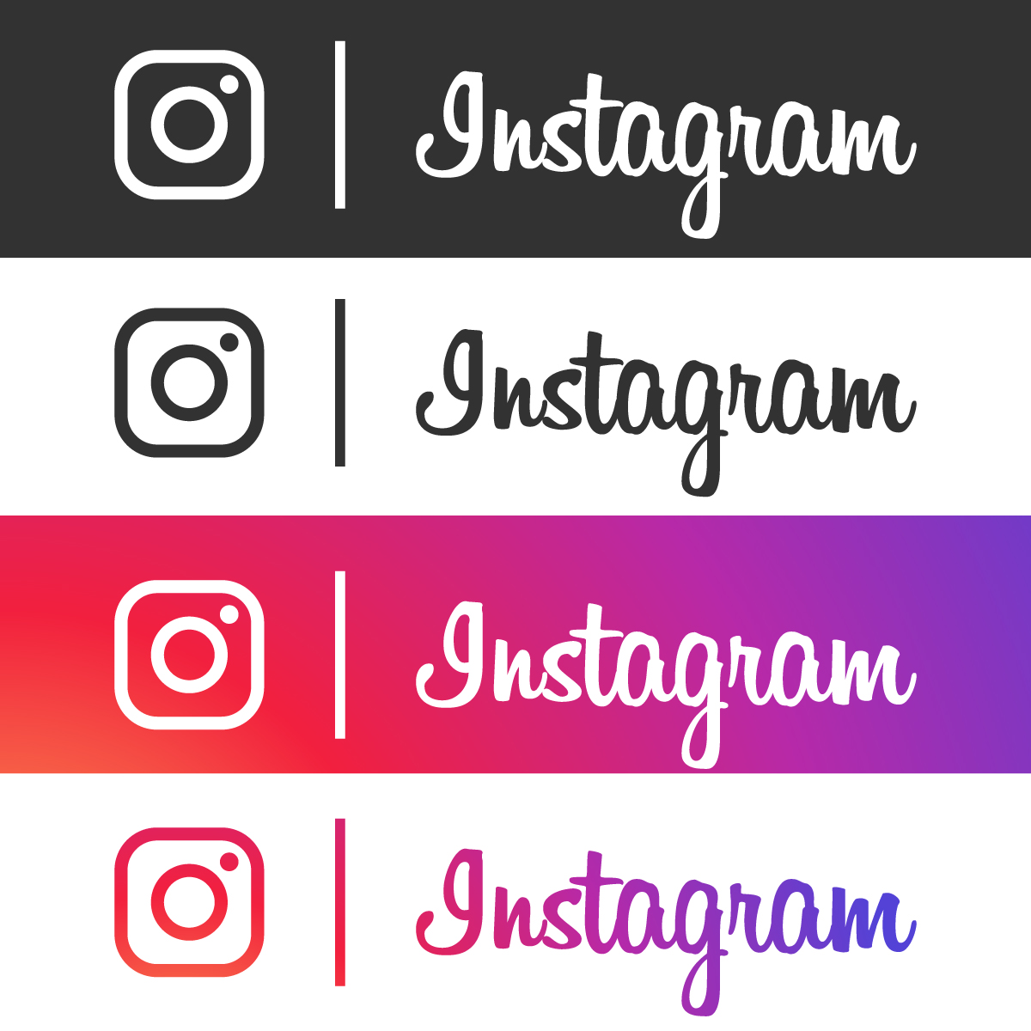
Social Media Analysis
BY Nitin Kumar

Slide 2

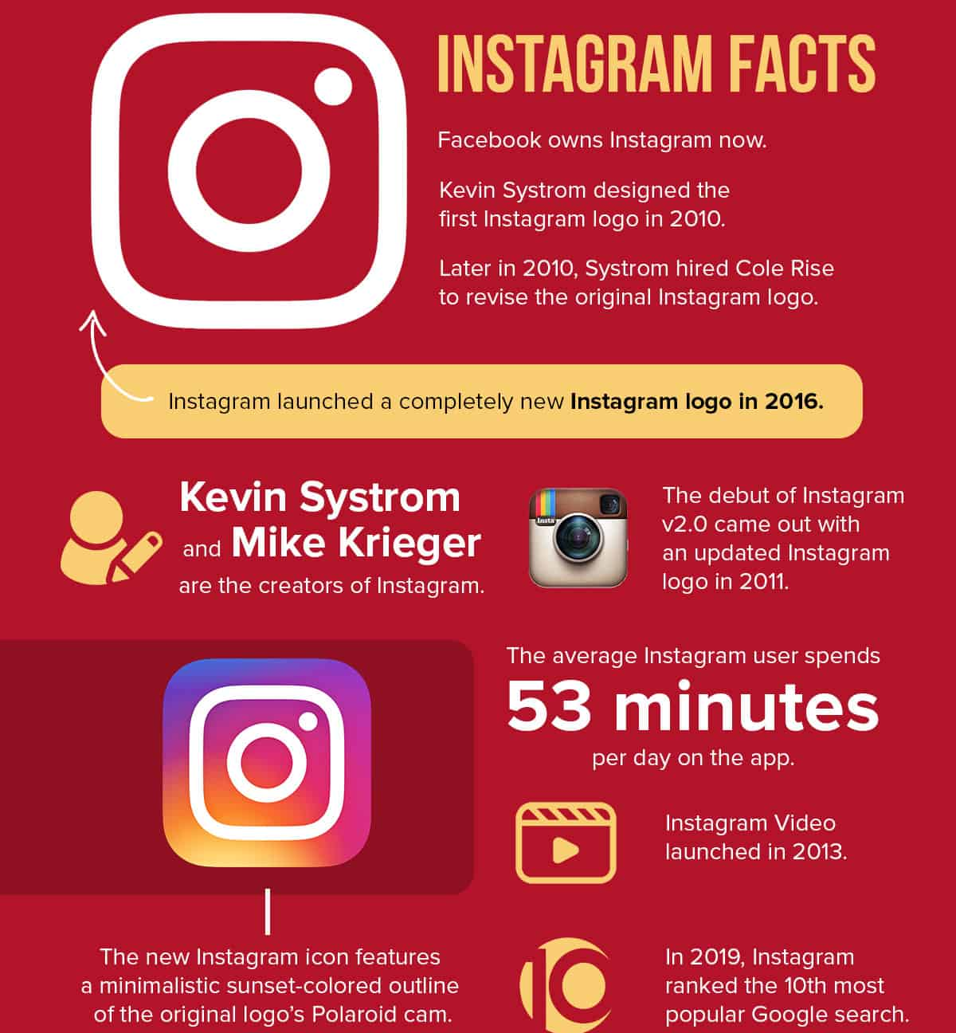
Some Interesting Facts :
Instagram launched in October 2010 and gained 1 million users within just two months. By 2018, it had soared to over 1 billion monthly active users..
In April 2012, Facebook acquired Instagram for approximately $1 billion in cash and stock, a move that underscored Instagram's rapid success and potential..
Instagram introduced Stories in August 2016, a feature inspired by Snapchat that allows users to share photos and videos that disappear after 24 hours. This feature quickly became a core part of the Instagram experience.
Approximately 71% of Instagram users are under 35 years old, highlighting its popularity among younger demographics and its impact on modern social media culture.
Instagram ads are highly effective, with 60% of users discovering new products through the platform. Additionally, 75% of Instagram users take action, such as visiting a website or making a purchase, after seeing an ad. This level of engagement makes Instagram one of the most influential platforms for advertisers seeking to connect with potential customers.
Now let’s analyse Instagram's user data to develop targeted marketing strategies.

Slide 3
Project Description
Did you know? Interactive Instagram ads, like those featuring quizzes, polls, or augmented reality (AR) filters, have been found to drive up to 25% more engagement compared to standard static ads!
Marketing team at meta wants to leverage Instagram's user data to develop targeted marketing strategies that will increase user engagement, retention, and acquisition.
As a data analyst at Meta we need to collaborate with Marketing team. Let’s come up with some insights and recommendations.

Slide 4
Approach/ Methodology
We aim to find answers to certain objective/subjective questions in order to arrive to a data driven decision through our insights and recommendation and help marketing team in developing strategies.
The key findings could be:
User activity Levels
Kinds of tags used
User total engagement levels
Popularity of user based on followers
Kinds of user generated content for personalised ads
Most popular hashtags
Re-engagement strategies of inactive users
Collaborating with the influencers
For the same we would use:
My SQL database for storing user data
Different grouping and aggregations in SQL to derive required metrics
Window Functions for rankings

Slide 5
Dataset
The data set consists of following tables containing user data :
Users: Information about user like username and user creation date.
Photos: Data related to photos posted on Instagram.
Comments: Data about the comments on Instagram posts.
Likes: Data about the likes on the posts.
Follows: User followers and following related data.
Tags: Tag involved in different posts.
Photo_tags: Junction table between photos and tags.

Slide 6
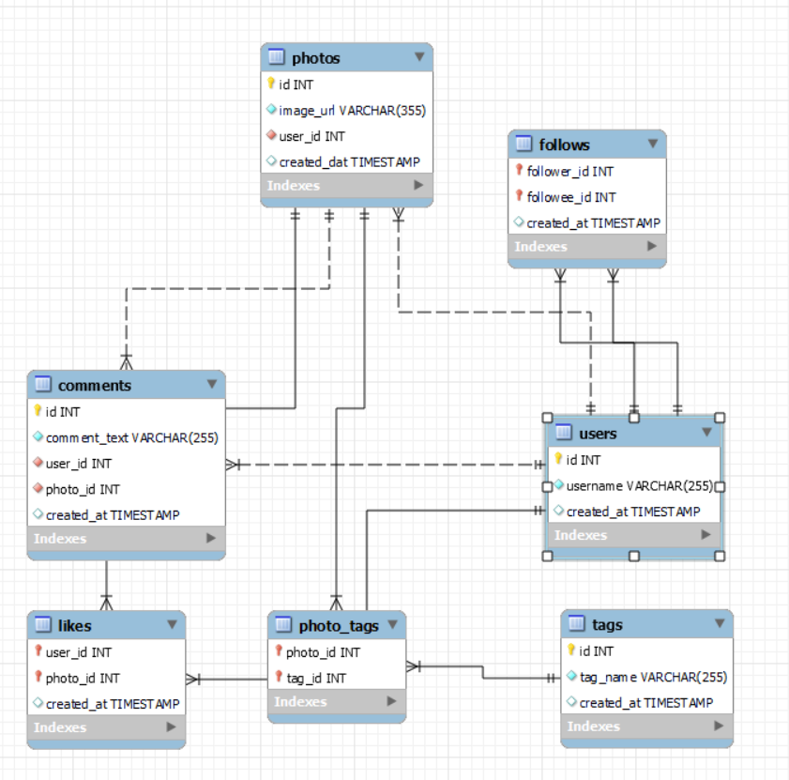
Database Schema

Slide 7
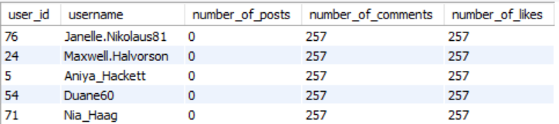
User activity
The key factors to analyse the user activity potentially include:
Number of post that user liked
Number of post that user commented on
Number of photos posted by user
Base on above factors following users tend to have highest activity levels.
posts
likes
comments

Slide 8
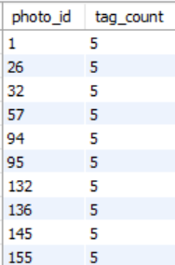
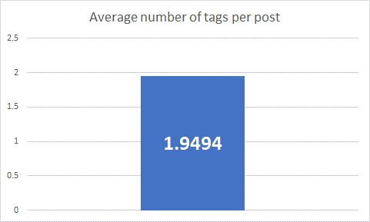
Photos and tags
As per out data set the photos with maximum number of tags are:
On an average each post had around 2 tags

Slide 9
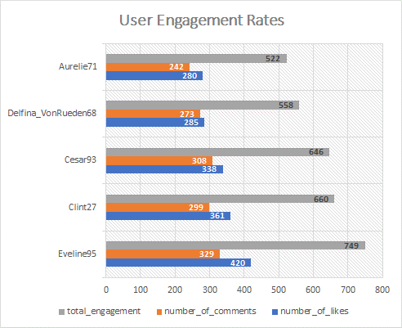
User Engagement Rates
To identify the top users with the highest engagement rates we calculated the total number of likes and comments on each user’s post and subsequently ranked the users based on them
Top 5 Users with highest total engagement rates on their posts.

Slide 10
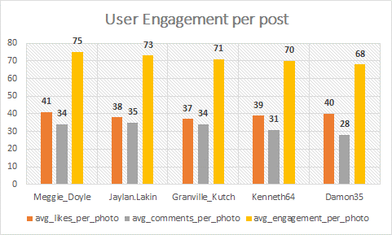
User Engagement Rates
We also calculated the average engagement per post for users and ranked them.
Top 5 Users with highest average engagement rates on their posts.

Slide 11
Leveraging User-Generated Content for Personalized Ads
Segment by Engagement: Target users who frequently interact with UGC.
Customize Content: Tailor ads based on popular posts and tags.
Retargeting: Show personalized ads to users who’ve previously engaged.
Interest Groups: Use content interaction and followers to group audiences.
Influencer Collaboration: Partner with popular influencers to boost engagement.
Outcome: Create ads that resonate, drive interactions, and enhance performance.

Slide 12
Guiding Content Strategies with User Activity Insights
INSIGHTS
Analyze Preferences: Track likes, comments, shares, and views by content type
Focus on Popular Content: Prioritize content types (photos, videos, reels) that drive higher engagement.
Optimize Content Mix: Allocate resources based on user preferences to boost engagement.
Experiment & Adapt: Continuously test different content types to align with evolving user interests.
Leverage Analytics: Use social media tools to track and optimize content performance

Slide 13
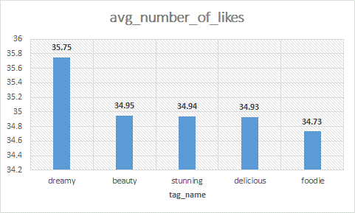
Most Liked Hashtags
The top five hashtags that have been used in posts with the highest average number of likes are as follows

Slide 14
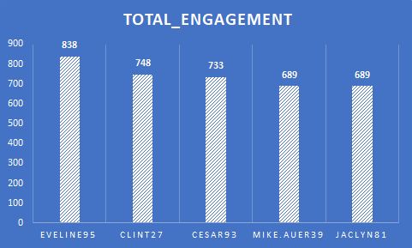
Most Loyal /Valuable users.
To determine the most loyal or valuable customers we considered these parameters to assess their engagement and activity levels:
Content liked by them.
Comments posted by them.
Photos posted by them.
Number of likes received on their posts.
Number of comments received on their posts.
Number of followers.
Number of followings.
Top 5 users

Slide 15
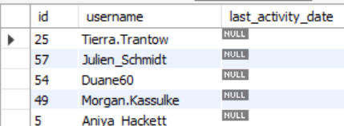
Inactive users and Re-engagement strategies
We identified inactive users based on last activity dates.
Re-Engagement Strategies
Personalized Email: Trigger re-engagement
Personal Outreach: Messages or special offers.
Surveys: Understand inactivity reasons.
Incentives: Discounts and offers.
Community Programs: Challenges and contests.
Gamification: Points and badges for recognition.

Slide 16
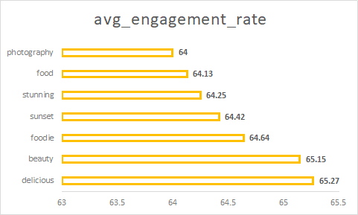
Content/ Hashtags with maximum engagement rates
We identified hashtags with maximum engagement.
Strategical Insights to leverage the data:
Use High-Engagement Hashtags: Boost visibility
Create Trending Content: Align with audience interests.
Launch Targeted Ad Campaigns: Focus on trending topics.
Monitor Ad Performance: Assess effectiveness of hashtags.
Invest in High-Engagement Topics: Maximize ROI.

Slide 17
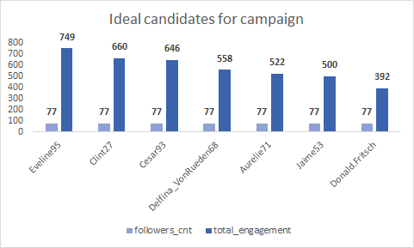
Ideal candidates for influencer marketing campaigns
We identified top candidates with high number of followers and content engagement
Influencer collaboration Strategy:
Send Personalized Messages: Highlight campaign fit.
Define Objectives & Benefits: Clarify goals and perks.
Discuss Compensation: Outline incentives.
Collaborate Creatively: Align with their style.
Implement Feedback Loops: Adapt strategies as needed.
Build Long-Term Relationships: Offer exclusives and appreciation

Slide 18
Optimising Ad Campaigns
Influencer collaboration Strategy:
Calculate CTR: Measure ad click attraction.
Calculate Conversion Rate: Assess clicks to actions.
Calculate ROI: Evaluate ad spend vs. returns.
Evaluate Campaign Metrics: Identify top-performing campaigns.
Test Ad Variations: Find the best-performing versions.
Adjust Messaging: Align with audience preferences.
Refine Target Audience: Adapt based on responses.
Reallocate Budget: Shift funds to high-performing ads.
Monitor Performance: Regularly update strategies.
Utilize Analytics Tools: Gain insights from platforms.

Slide 19


Conclusion
To conclude we could say that, by integrating data-driven insights and strategic approaches, we can enhance user engagement, optimize ad campaigns, and drive successful marketing initiatives.
Data Utilization for Targeted Marketing Leverage user-generated content and engagement data for personalized ad campaigns and effective targeting.
Content Strategy Insights Focus on high-engagement hashtags and trending topics to guide content creation and ad strategies.
Influencer Collaboration Personalize outreach, define clear objectives, and build long-term relationships for successful partnerships.
Ad Campaign Optimization Measure effectiveness using CTR, Conversion Rate, ROI, and adjust based on performance metrics.
Continuous Improvement Monitor, test variations, and refine strategies regularly using analytics tools for ongoing optimization

Slide 20


